Slide 1
My MHD code
Justin Angus

Slide 2
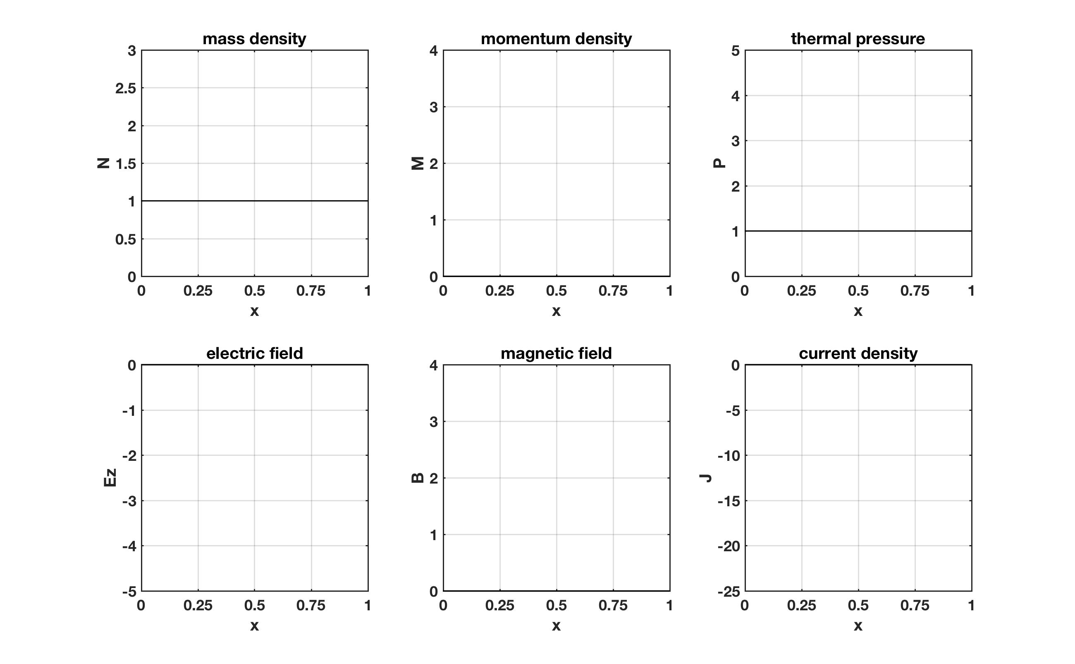
2 Torr D with kJ pulse

Slide 3
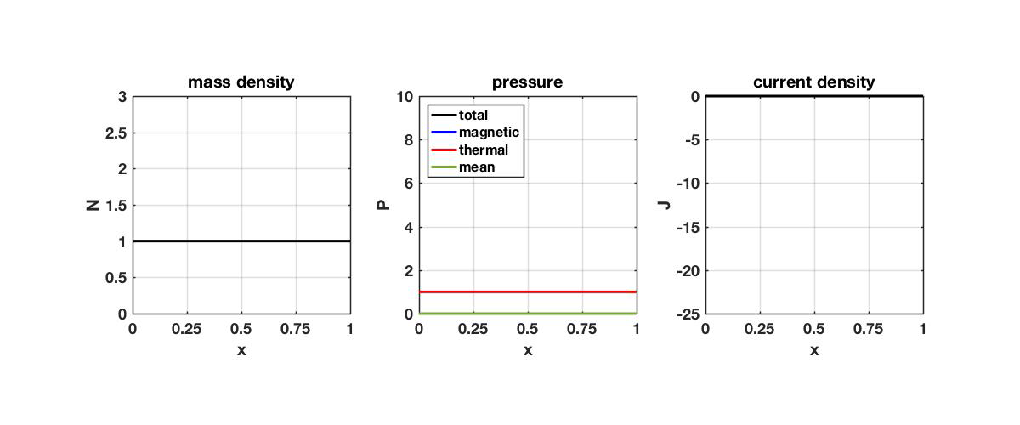
2 Torr D with kJ pulse

Slide 4
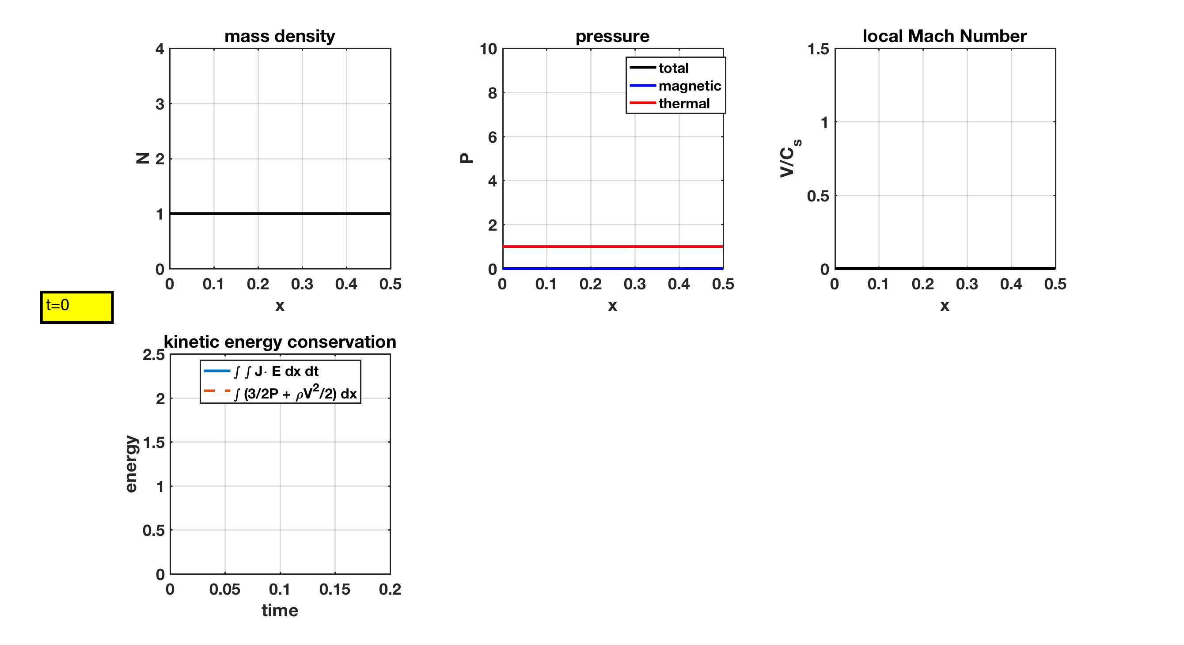
Energy conservation seems to degrade once shock sets it

Slide 5
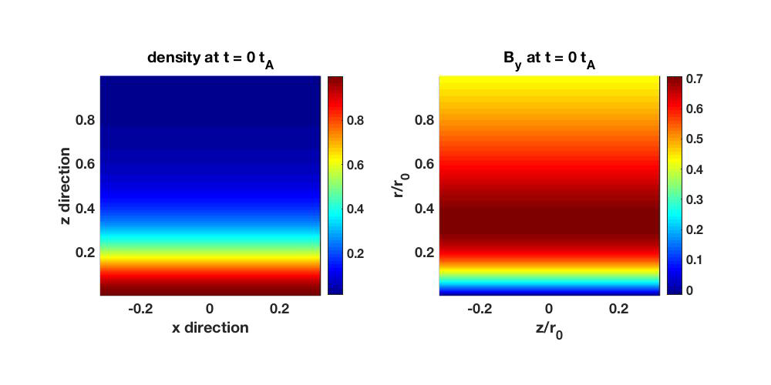
kR=10, nz=80, nr=400

Slide 6

kR=10, nz=80, nr=800 (slight asymmetry in z?)

Slide 7
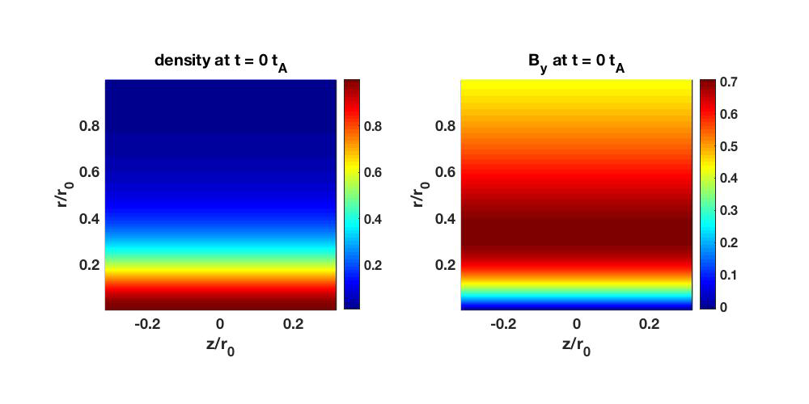
kR=10, nz=160, nr=800

Slide 8
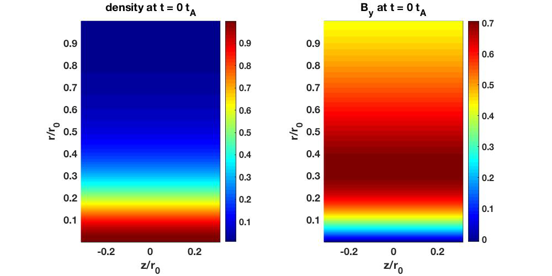
kR=10, nz=160, nr=800 (to scale)

Slide 9
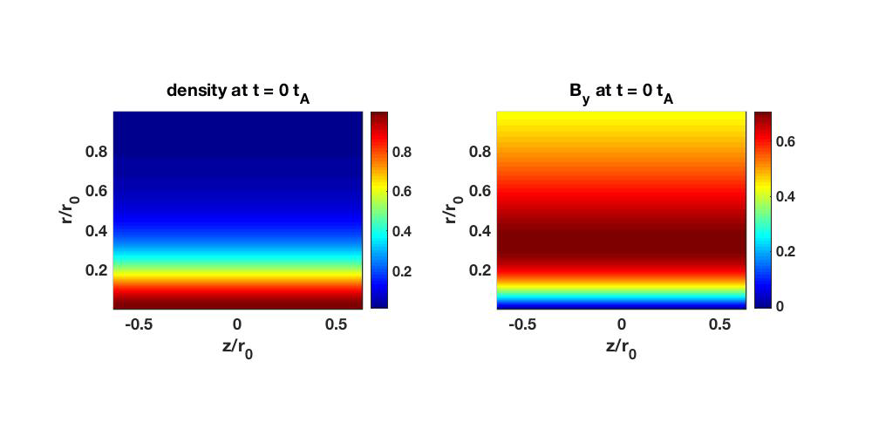
kR=5, nz=160, nr=800 (to scale)

Slide 10
kR=5, nz=160, nr=800 (to scale)

Slide 11
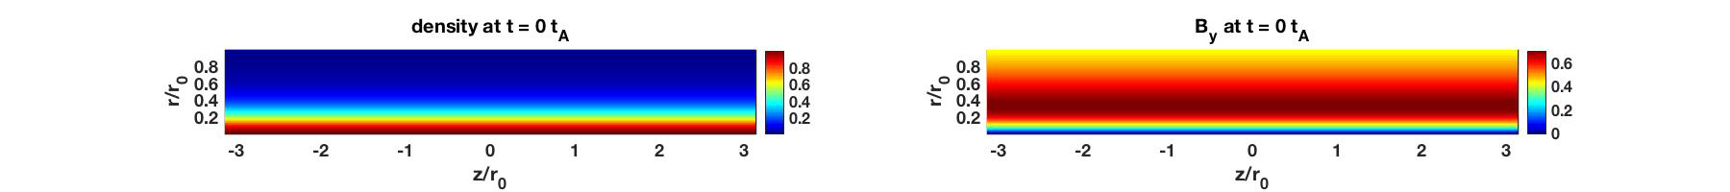
kR=1, nz=160, nr=800 (top), nz=320 (bottom)

Slide 12
Fourier amplitudes for seeded kR=10 mode
80x400
160x800
400x800
Development of 3rd harmonic during linear stage is kinda wonky
Never really observer linear stage for kR=30
Odd Fourier modes develop in highest resolution sim
Evolution of these modes during nonlinear saturation are similar for each resolution
Growth rates are
1.07 (kR=10)
2.14 (kR=20)
NA (kR=30)

Slide 13
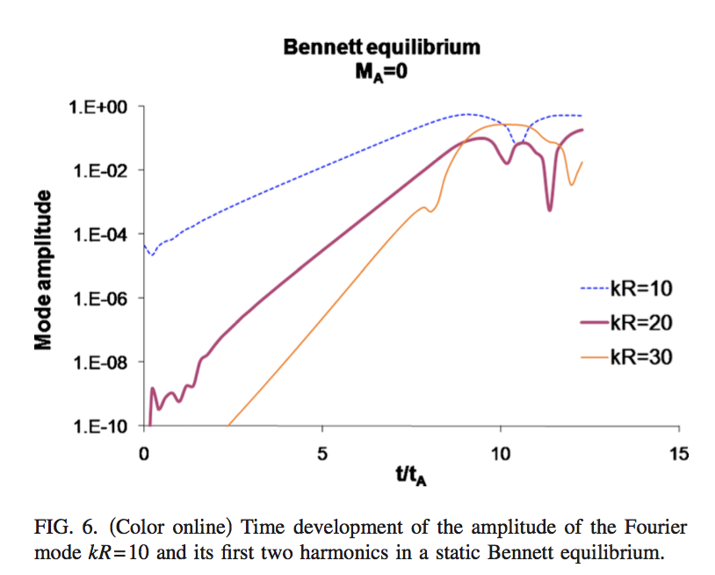
Mode analysis for kR=10 seed agrees well with that from Parashiv 2010 for first and second harmonics
Parashiv 2010 pop
Linear stage matches well for first and 2nd harmonic
3rd harmonic in my simulation is kinda wonky during linear stage
Nonlinear saturation stage from my sim matches their sim very well for first 3 harmonics
Growth rates from my sim are
1.07 (kR=10)
2.14 (kR=20)
NA (kR=30)
Growth rates from Parashiv 2010 are
1.07 (kR=10)
2.08 (kR=20)
3.02 (kR=30)
My sim

Slide 14
Linear growth of 3rd harmonic is observed when doing Fourier analysis of entropy density (S)
From density (N)
From S=P/N^{γ-1}
kR = 10 seeded
Growth rates from N
1.07 (kR=10)
2.14 (kR=20)
NA (kR=30)
Growth rates from S
1.07 (kR=10)
2.14 (kR=20)
3.28 (kR=30)
Theory suggests higher harmonics should have linear growth rates proportional to k

Slide 15
Fourier amplitudes for seeded kR=5 mode
80x400
160x800
320x800
Development of 3rd harmonic during linear stage is kinda wonky
Only in highest resolution sim does there appear to be a linear phase to the 3rd harmonic
Odd Fourier modes develop in highest resolution sim
Evolution of these modes during nonlinear saturation are similar for each resolution
Growth rates are
0.90 (kR=5)
1.62 (kR=10)
2.75 (kR=15)

Slide 16
Linear growth of 2nd and 3rd harmonics is closer to theory when looking at entropy density (S)
From density (N)
From S=P/N^{γ-1}
kR = 5 seeded
Growth rates from N
0.90 (kR=5)
1.62 (kR=10)
2.75 (kR=15)
Growth rates from S
0.90 (kR=5)
1.81 (kR=10)
2.71 (kR=15)
Theory suggests higher harmonics should have linear growth rates proportional to k

Slide 17
Fourier amplitudes for seeded kR=1 mode
80x200
80x400
160x800
Evolution of these modes during nonlinear saturation are not similar for each resolution
Higher z-resolution ➔ higher dominant mode near saturation
Growth rates from 160x800 sim are
0.30 (kR=1)
0.55 (kR=2)
0.69 (kR=3)

Slide 18
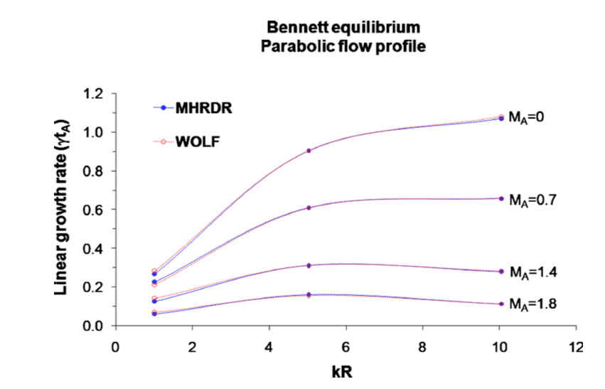
Seeded mode growth rates from shear-free sims matches well with Paraschiv 2010
Seeded mode growth rates from simulations are (indicated by red arrows placed on Fig. 2 of Paraschiv 2010)
1.07 (kR=10)
0.90 (kR=5)
0.30 (kR=1)

Slide 19
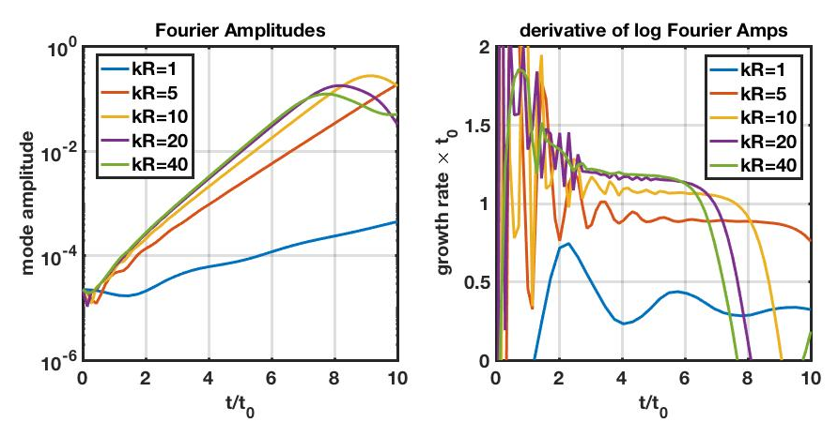
Seeded mode amplitudes vs time from Ideal MHD
kR | γt₀
1 | 0.3
5 | 0.9
10 | 1.07
20 | 1.16
40 | 1.18

Slide 20
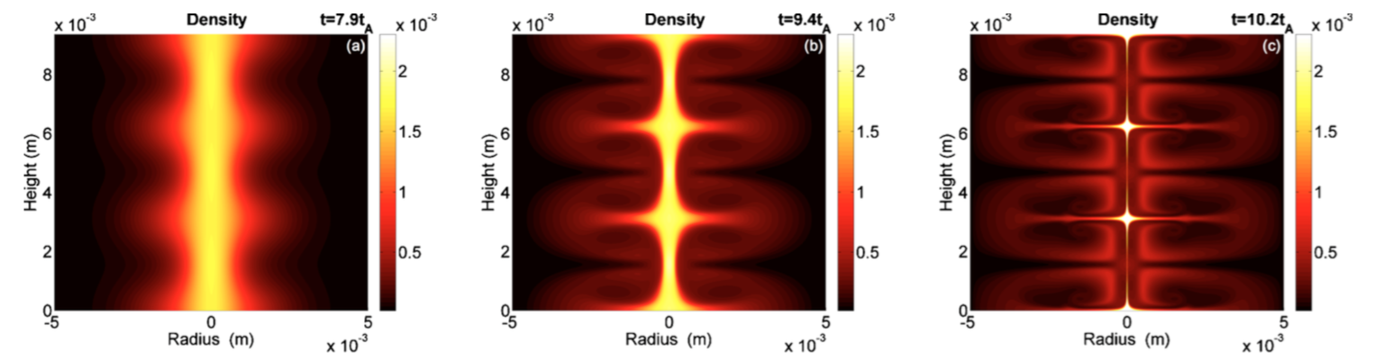
Density contours for seeded kR=10 mode at different stages in good agreement with other sims
I tried to follow their normalization, but off by about 10
Resolution in 2010 pop paper is said to be 80 in z for each mode and 1000-1500 in r
My resolution is 80 in z for each mode and 800 in r
Last time slices are at slightly different times
Paraschiv 2010
Angus 2018

Slide 21
Density contours for seeded kR=10 mode at different stages in good agreement with other sims
I tried to follow their normalization, but off by about 10
Resolution in 2010 pop paper is said to be 80 in z for each mode and 1000-1500 in r
My resolution is 400 in z for each mode and 800 in r
Last time slices are at slightly different times
Paraschiv 2010
Angus 2018

Slide 22
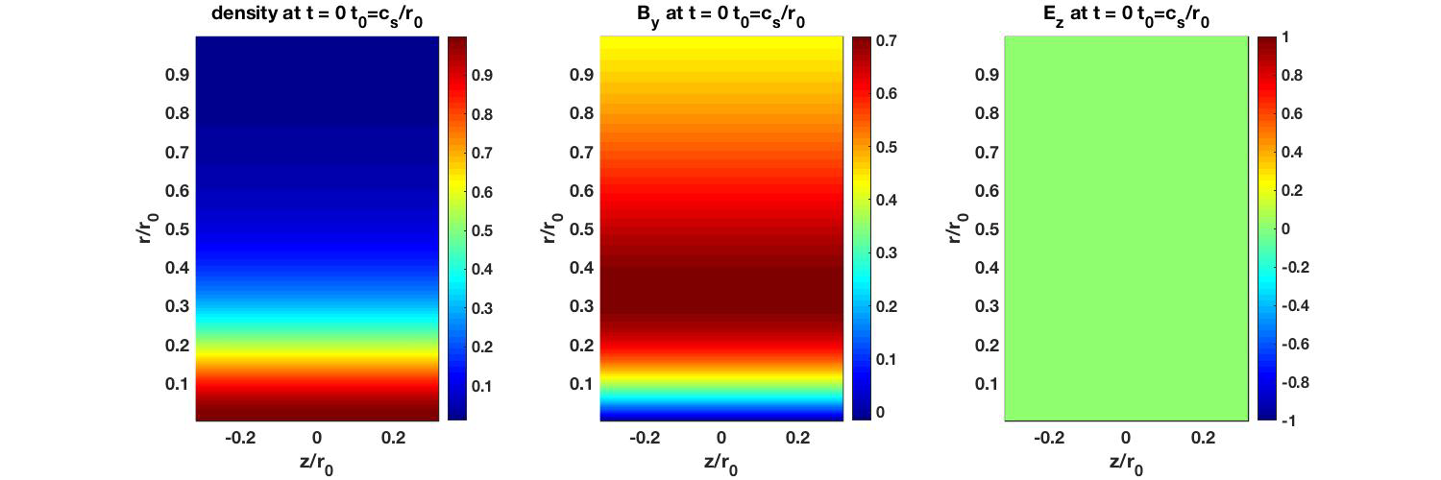
Hall MHD (JxB and gradP) (Li/r0=5.0e-3)

Slide 23
Hall MHD (JxB and gradP) (Li/r0=1.0e-1)

